Slide 1

NUCLEAR PLANT-ROBO
COST EFFICIENT ROBOT

Slide 2
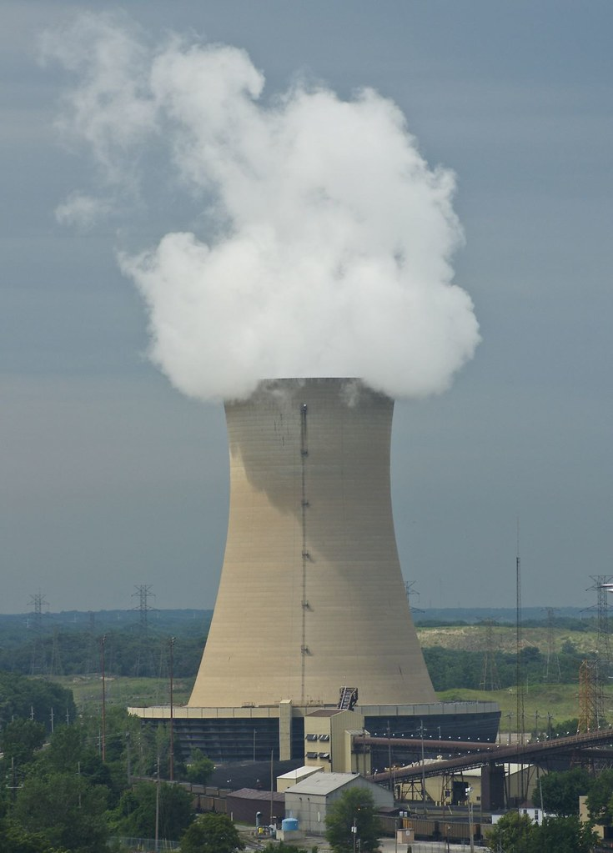
INTRODUCTION
NUCLEAR PLANT-ROBO
A nuclear power plant accident which affected the most of the living and the future generation- Chernobyl disaster. The most notorious nuclear power plant accident occurred at the station of Pripyat in the north of Ukrainian SSR in the Soviet Union. A disaster which shook the entire world in early months of ’86. Till now, there are nuclear power plant all around the globe, but to the miracle the radiation affects due to those plants didn’t reduce and it causes serious health problems. To overcome such kind of tragedy- We can use mobile robots for surveillance and other kind of jobs where the radiation affects are more. The mobile robots can be automated by humans- the sole purpose of this kind of attempt is to produce healthy society and also the technological improvement. And also, to ensure an event like Chernobyl doesn’t occur in the future.
This Photo by Unknown Author is licensed under CC BY

Slide 3
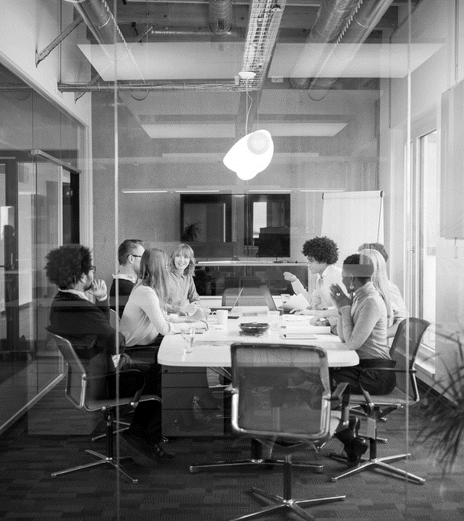
Agenda
INTRODUCTION
AGENDA
OBJECTIVES
WORKING AND PRINCIPLE
SPECIFICATIONS
BLOCK DIAGRAM
SUMMARY
QUERIES TIME

Slide 4

NUCLEAR STATION-ROBO
LET’S DIVE IN
OBJECTIVES:
DEVELOPING NEW TECH-ROBO IN MARKET.
AVOIDING MAN-HANDLING OF NUCLEAR MATERIAL.
MINCING HUMANOID ROBOT.

Slide 5
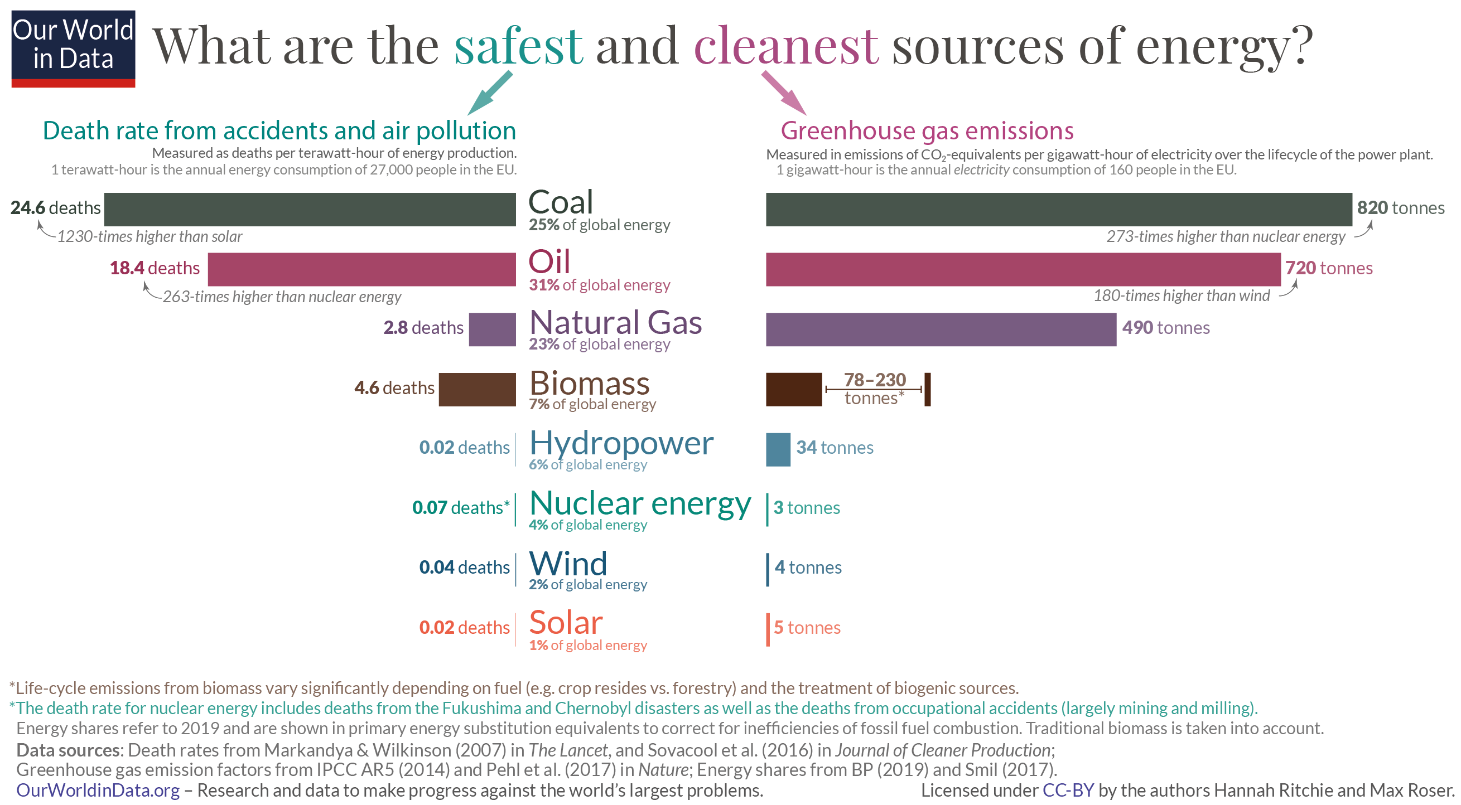
Death rate toll

Slide 6
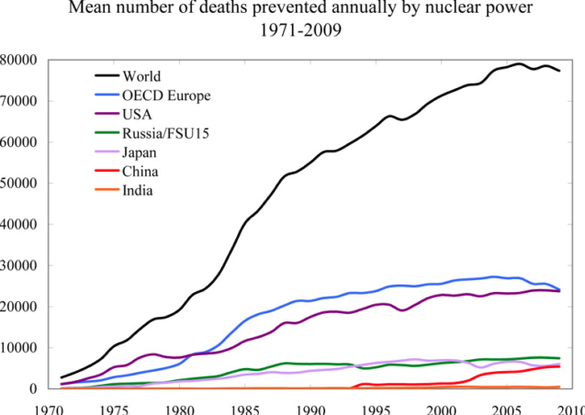
DEATH RATE PREVENTION by COUNTRIES

Slide 7
Svetlana Alexievich
That’s how it was in the beginning. We didn’t just lose a town, we lost our whole lives.

Slide 8
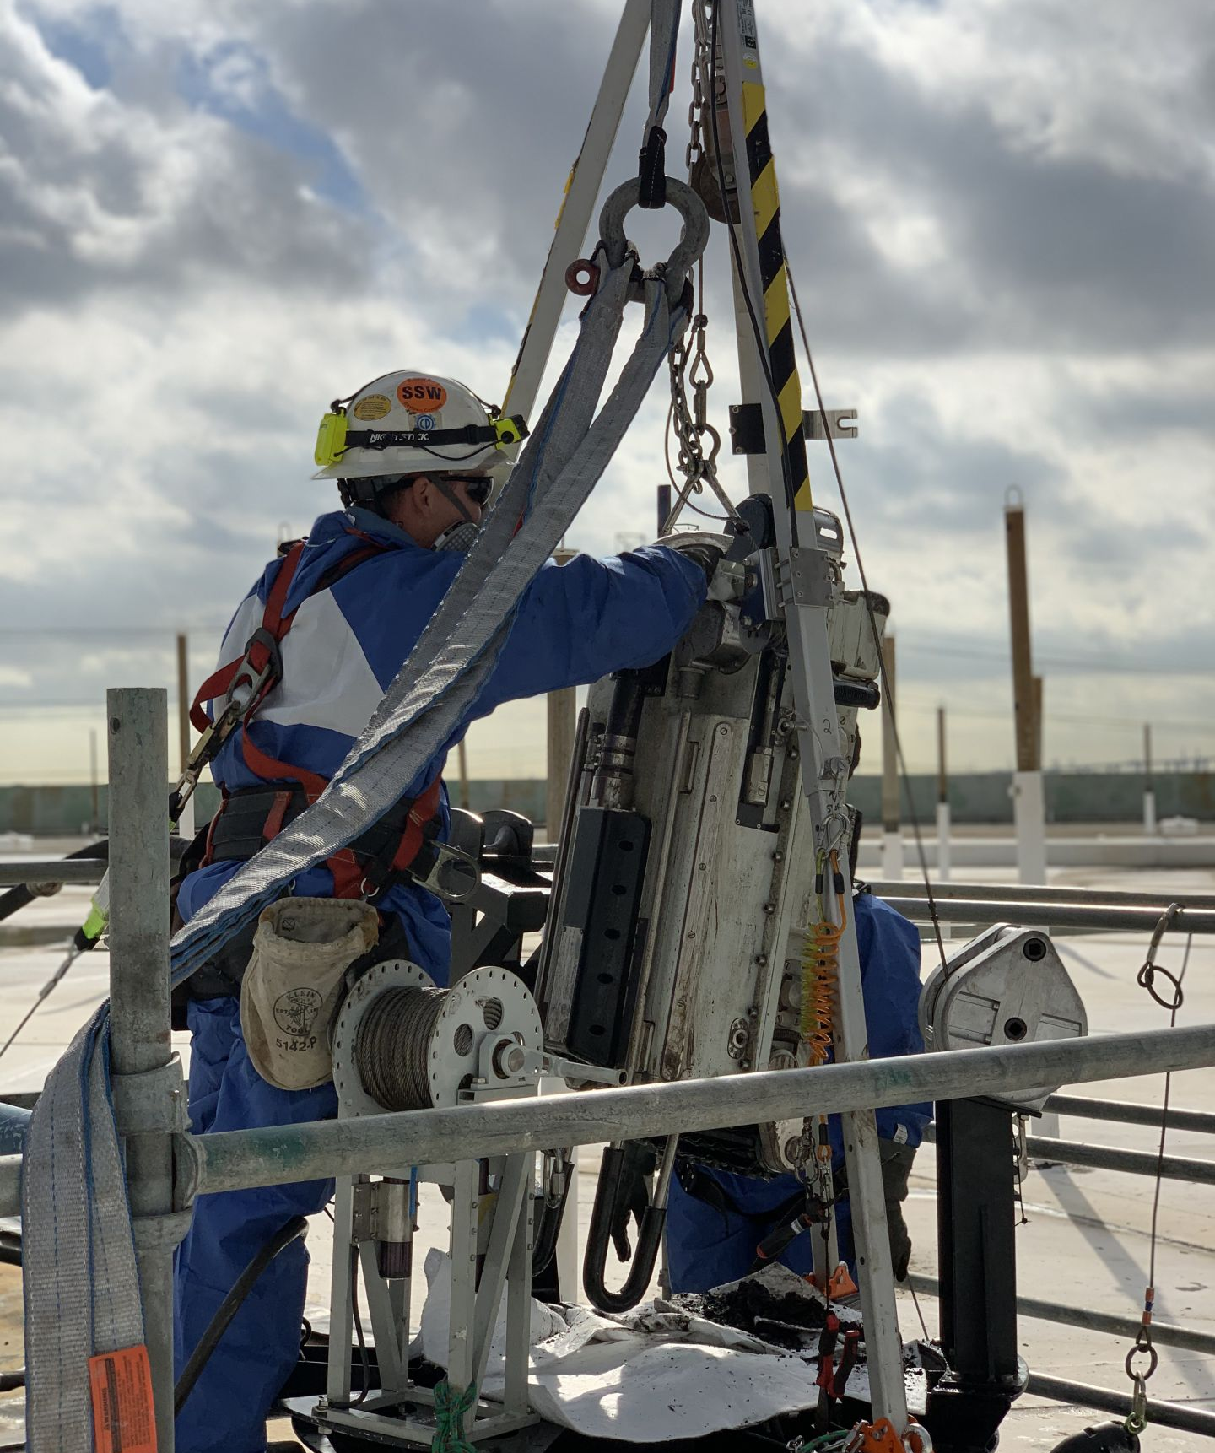
What’s next
Working and specifications

Slide 9
WORKING WAY
1ST |  |  | 2ND |  |  | 3RD |  |  | 4TH
 | INITIALIZATION |  | MID-RANGE WORKING |  |  |  | THEME JOB |  |  | FINAL
The nuclear Robo of ours work in the way of checking the flaws(surveillance) of the nuclear power plant around. So it will check and reports the flaws it found. |  |  | After checking the flaws- it confirms there is an error in the particular area. And it reports it to the supervisor/controller of the robot for further more steps for rectification. |  |  | Main theme- First of all, this Robo is already in the market but our idea is to operate(surveillance) the Robot from house itself with mobile phones(Chat bots). |  |  | If there is no flaw found, Robo keeps on checking the flaws present in the area. If error is found, it transmits error to the controller and the rest of the jobs are done for fixing by the nuclear station engineers.

Slide 10
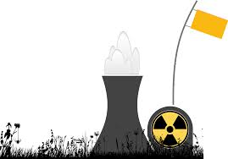
FLOW CHART OF WORKING WAY
INITIALIZATION
ROBOT ROUNDS THE POWER PLANT AND CHECKS FOR FLAW
ERROR IS FOUND!!!
TRANSMITS THE ERROR DETECTED TO THE CONTROLLER
If
Else
KEEPS ON SEARCHING FOR FLAWS IN THE AREA

Slide 11
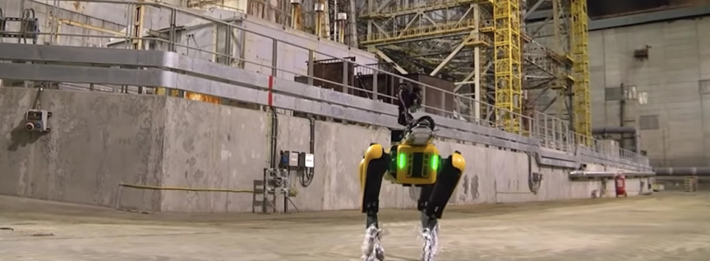
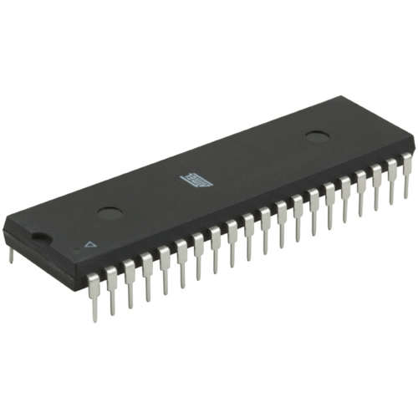
Components used
Basic Components
Sensors used
Microcontroller
Motors and Wheels
Temperature sensor
Radiation sensor
Camera
Ultrasonic sensor
Proximity sensor
GPS and GSM

Slide 12

SUMMARY
TEMPERATURE AND RADIATION SENSOR
Detects the temperature and radiation levels
CAMERA
Capture the image of the flaw
PROXIMITY SENSOR
Detects the level of nuclear waste in the tanker
ULTRASONIC SENSOR
Detects the distance of the level of nuclear radiation and other purposes

Slide 13



THANK YOU
MURALIDHRAN P
8248532278
muralidharan.ec20@bitsathy.ac.in
THINK BIG

